Slide 1


UNIVERSIDAD AUTÓNOMA DEL ESTADO DE HIDALGO
ESCUELA SUPERIOR DE ZIMAPÁN
Licenciatura en Derecho
Tema: Past Simple regular and irregular verbs
L.E.L.I. Maria del Rosario Nolasquez Trejo
Enero – Junio 2014

Slide 2
Tema: Past Simple regular and irregular verbs.
Resumen (Abstract)
Estudiar verbos regulares e irregulares en pasado.
Se practicara pronunciación de verbos regulares e irregulares.
Se explicara el uso del Pasado Simple de verbos regulares e irregulares.
To learn regular and irregular verbs in past form.
To practice pronunciation past verbs.
To explain the use of simple past regular and irregular verbs.
Palabras clave: (keywords)
Simple past (I did)

Slide 3
Objetivo general: El alumno será capaz de hablar sobre eventos en el pasado así como proporcionar y solicitar información básica de manera escrita y oral acerca de acciones y actividades que indiquen posibles eventos en el futuro, intenciones, posibles planes y promesas.

Slide 4
Nombre de la unidad: Hablar acerca de eventos del pasado
Objetivo de la unidad: Entender y proporcionar información referente al pasado con el fin de compartir anécdotas personales, narrar historias simples y sucesos que ya ocurrieron.

Slide 5
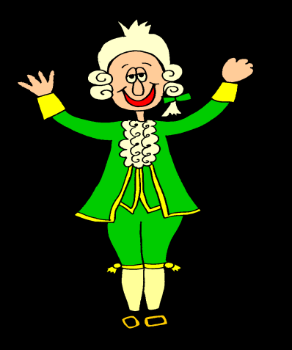
Tema: Past simple regular and irregular verbs
1.1. Hablar acerca de eventos del pasado.
Introducción:
We uses the simple past to describe and action or event in the past that have been completed.
The Past Simple is the same for all subjects:
This is Wolfgang Amadeus Mozart. He was an Austrian musician and composer. He lived from 1756 to 1971. he started composing at the age of five and wrote more than 600 pieces of music. He was only 35 years old when he died.
1756-1791

Slide 6

Desarrollo del tema:
was
lived
started
wrote
died
are all past simple
Very often the Past simple ends in –ed for example:
I work in a travel agency now. Before that I worked in a department store.
The police stopped me on my way home last night.
Laura passed her exam because she studied very hard.
worked
passed
studied
stopped
are all regular verbs.

Slide 7
But many verbs are irregular. Past simple irregular verbs do not end in –ed for example
The past simple of write is wrote.
The past simple of see is saw.
The past simple of go is went.
The past simple of shut is shut.
Mozart wrote more than 600 pieces of music.
We saw Tanya in town a few days ago.
I went to the cinema three times last week.
It was cold, so I shut the window.

Slide 8
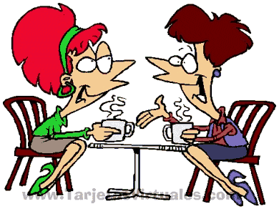
In questions and negative we use did and didn’t + infinitive verbs.
Did you enjoy?
Did she see?
Did they go?
I enjoyed
She saw
They went
You didn’t enjoy
She didn’t see
They didn’t go
Yes, I went to the cinema, but I didn’t enjoy the film much.
Did you go out last night?

Slide 9

In the next example do is the main verb of the sentence.
We say:
We don’t say
We don’t say:
We say:
We don’t say:
What did you do at the weekend?
What did you at the weekend?
I didn’t do anything.
I didn’t anything

Slide 10
Conclusión o cierre:
To learn more about regular and irregular verbs you can check this page.
http://www.ompersonal.com.ar/omverbs/regularverbs.htm

Slide 11
Bibliografía del tema:
(Establecer referencias bibliográficas. ( mínimo 3)
Redston, C. y Cunningham, G. (2005). Face2face Elementary Student’s Book. Italy: Cambridge.
Ompersonal. (1999). Recuperado el 24 de marzo de 2014, de ompersonal:http://www.ompersonal.com.ar/omverbs/regularverbs.htm
Murphy, Raymond. (2001). English Grammar In use. Great Britain:Cambridge University Press.

